Slide 1


DXC REALTIME PROJECTS
AZ-900, DP - 203
JUNE 10, 2022
DXC TECHNOLOGY PVT.LTD.

Slide 2
Name: Rohan Kumar Jayswal
Reg No: DXC262AB1216
Project1 Name : - Smart Vehicles
Date: 10 June,2022

Slide 3
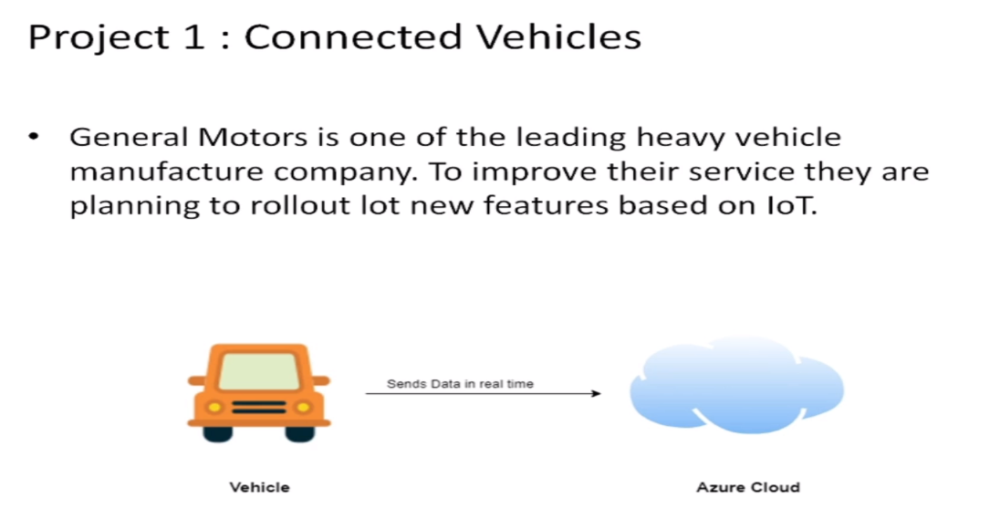
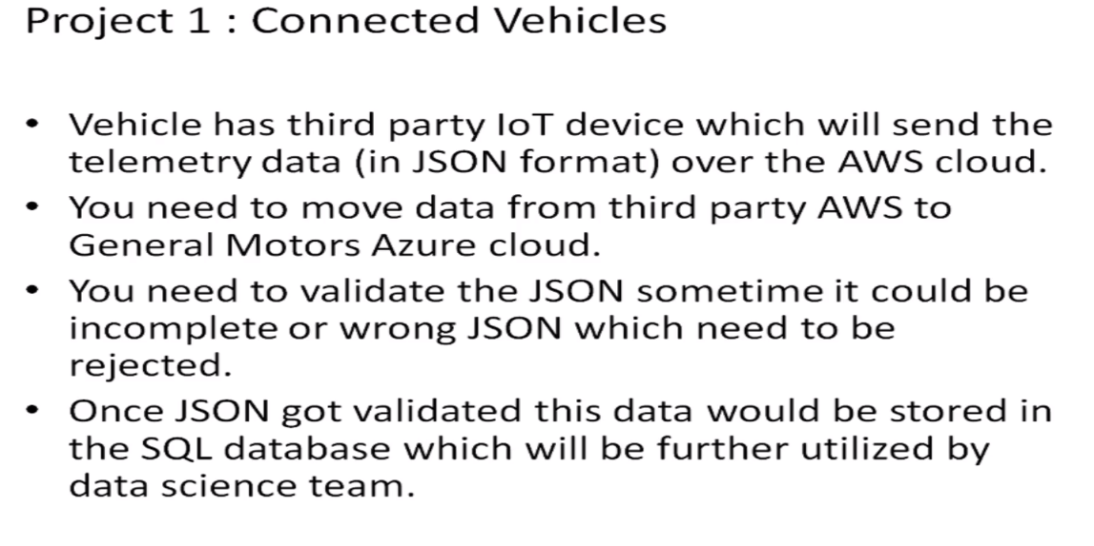
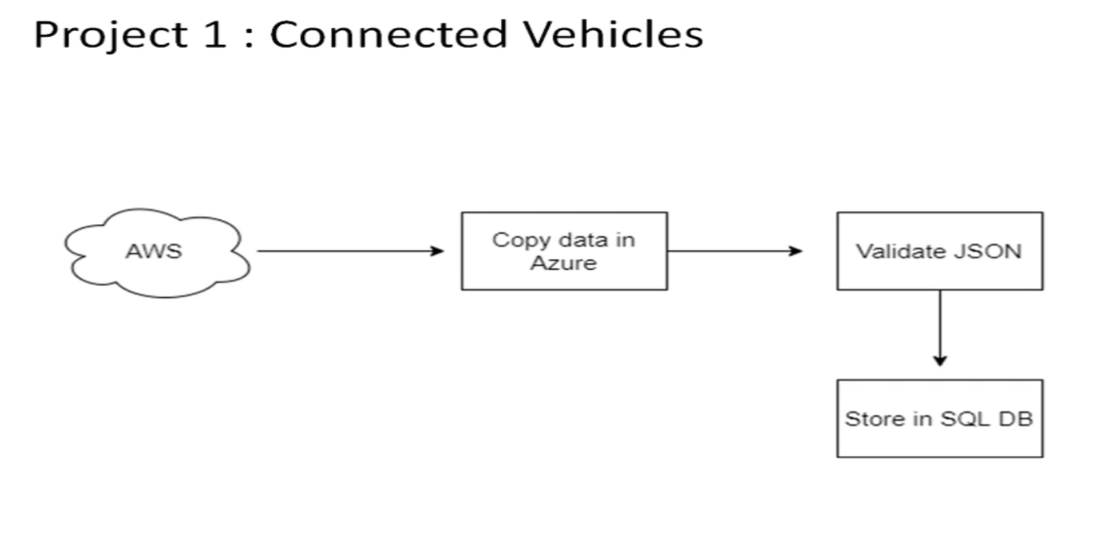
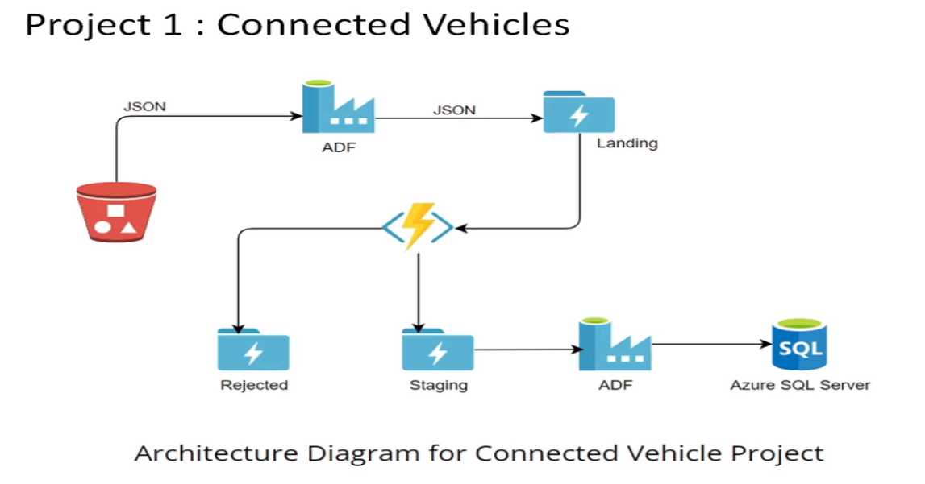

Slide 4
Practical Lab: Create Azure Data Factory Account For Data pipelines
Practical Lab: Create ADF Pipeline End to end pipeline with triggers enable
Practical Lab: Create Azure blob trigger logic
Practical Lab:Create Azure SQL Server and Database
Practical Lab: Add another pipelines for moving data from Staging to SQL DB

Slide 5
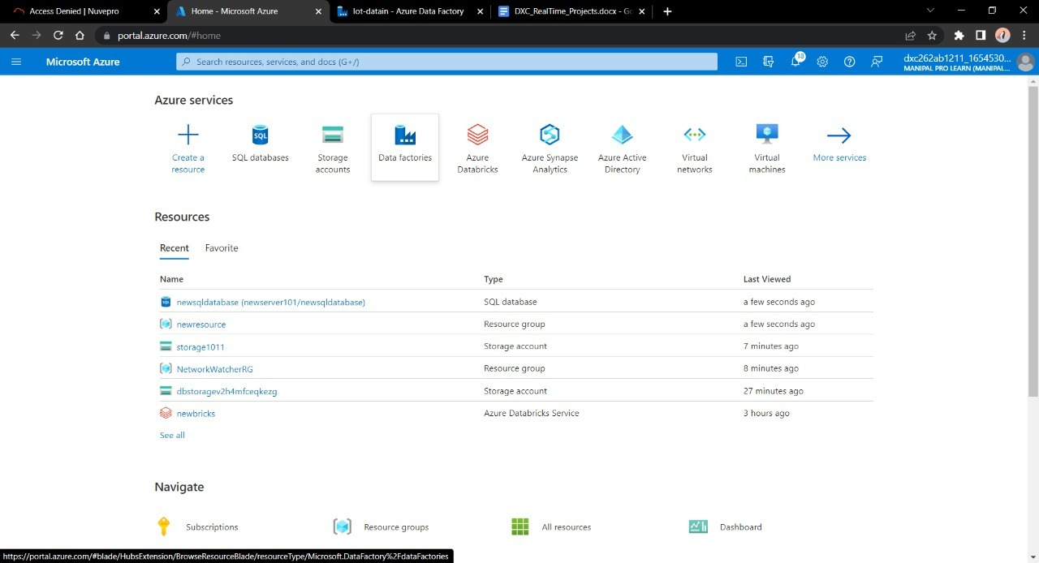
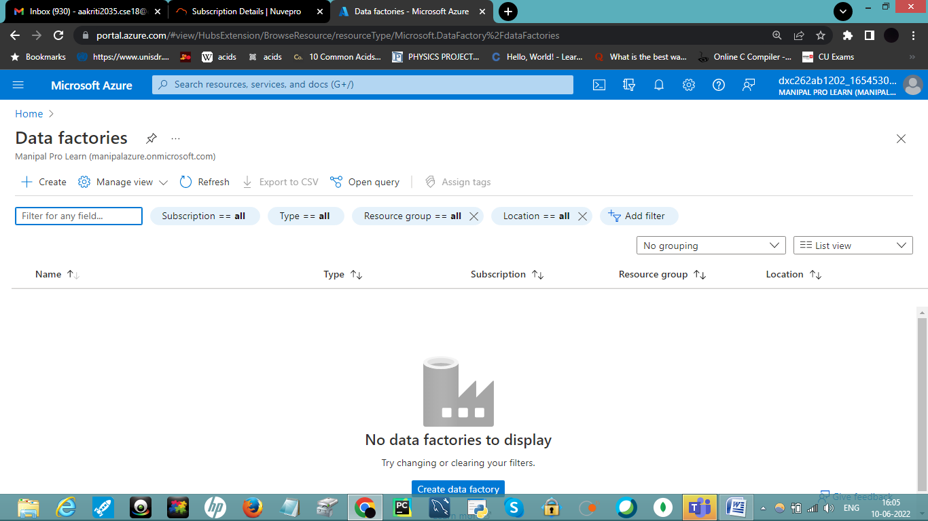
TO FULLFILL THE CASES FOLLOW THE STEPS AS MENTIONED BELOW:
STEP-2
Open the Azure Data Factory , Click on + Create option to create a new Data Factory account:
STEP-1
Open the Microsoft Azure and search for Azure data Factory:

Slide 6
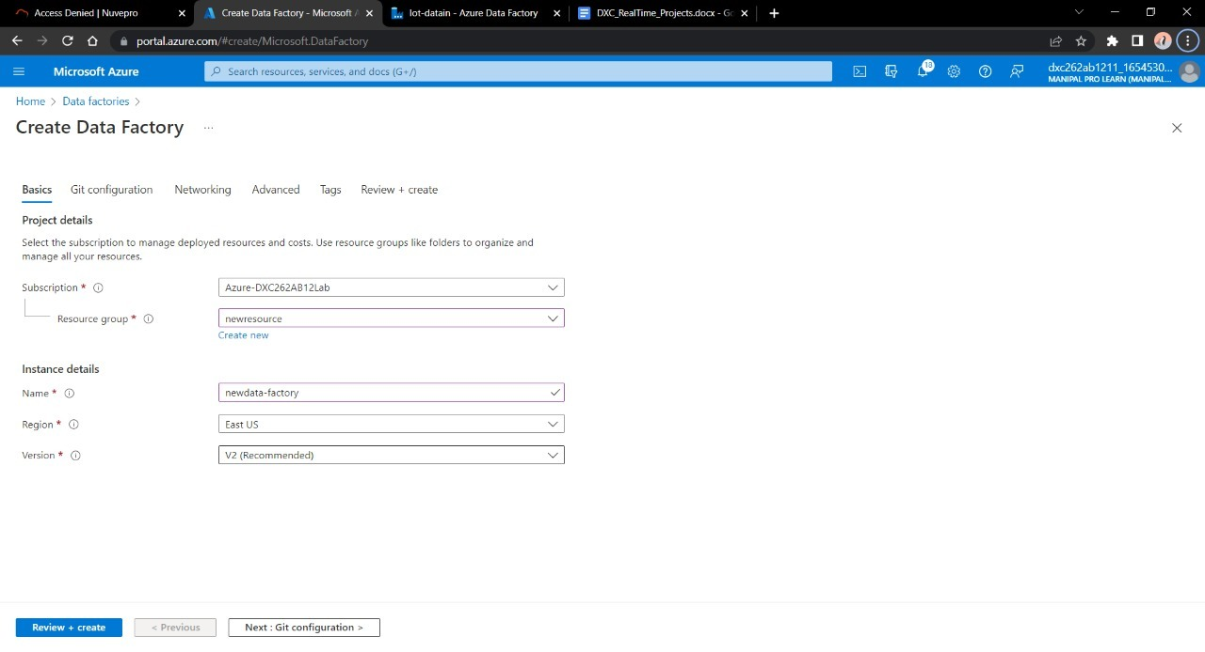
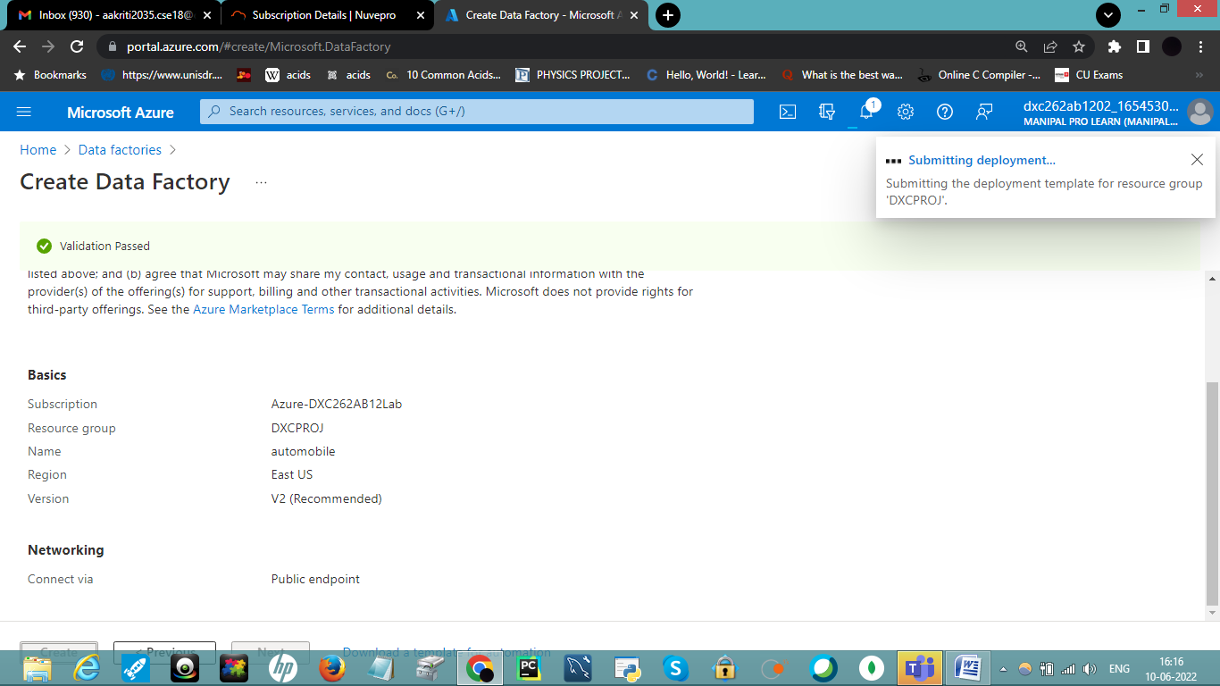
STEP 3 :- Enter the details for your Data factory account
STEP 4 :- After entering the details move towards validating the fields and Click on Create when successfully validated.

Slide 7
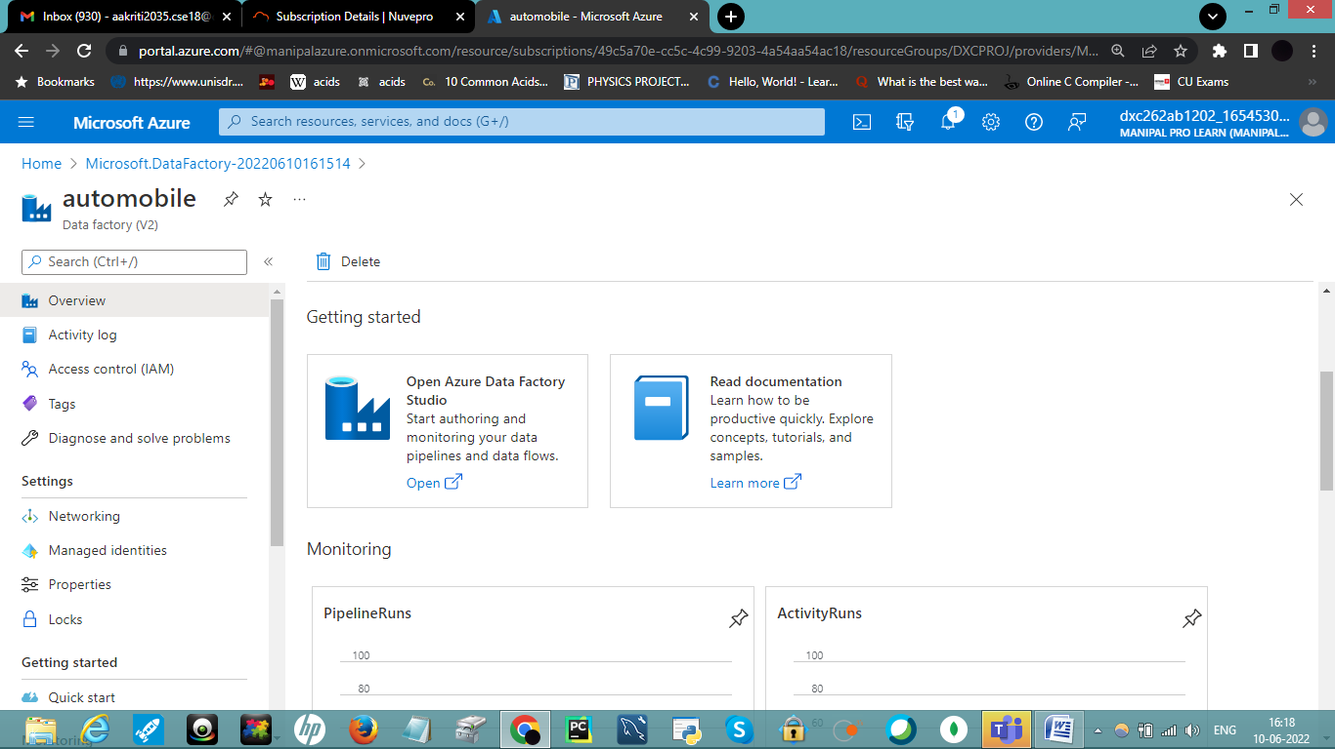
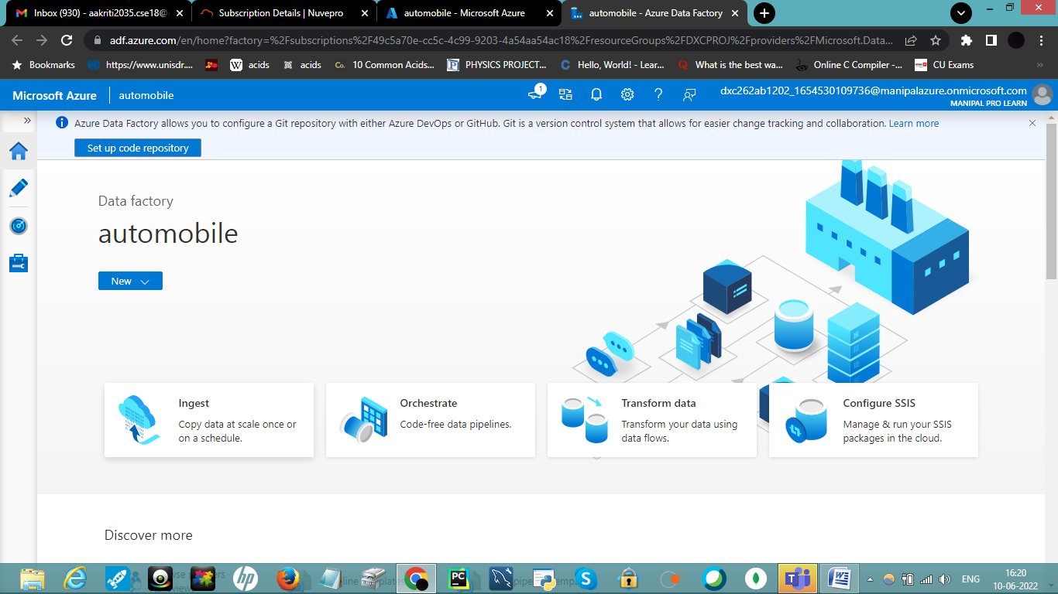
STEP 5:- After deployment is completed , click on Go to Resource Group.
STEP 6:- Click on Open Azure Data Factory.

Slide 8
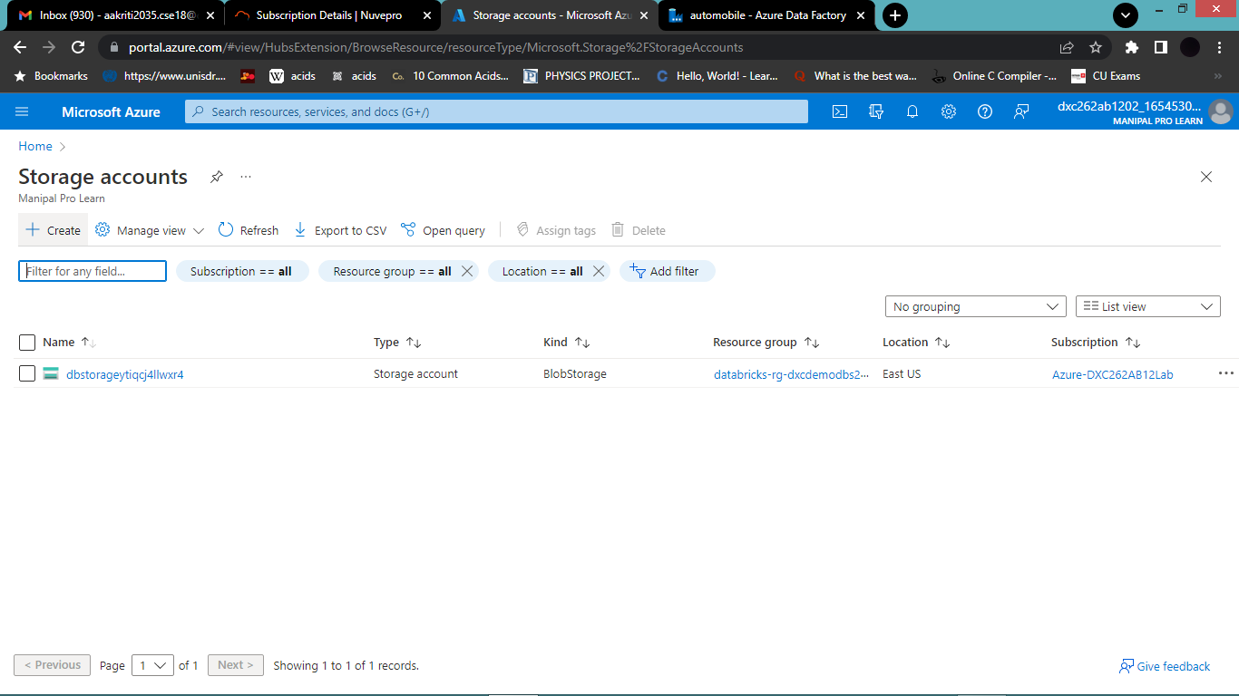
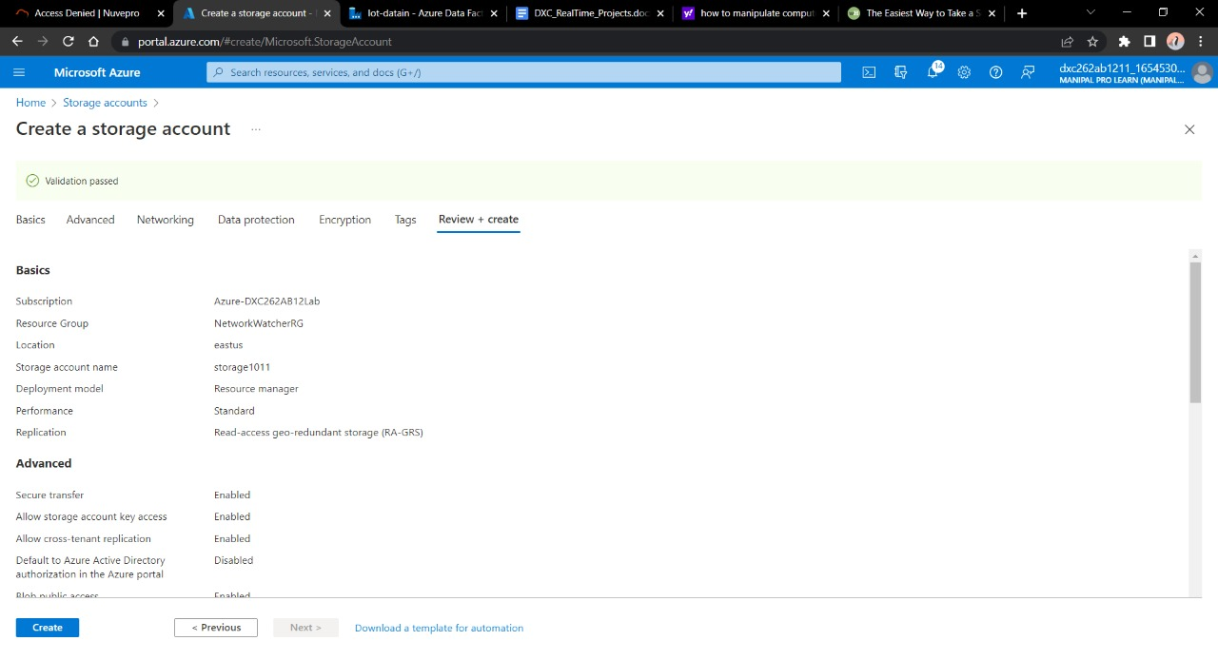
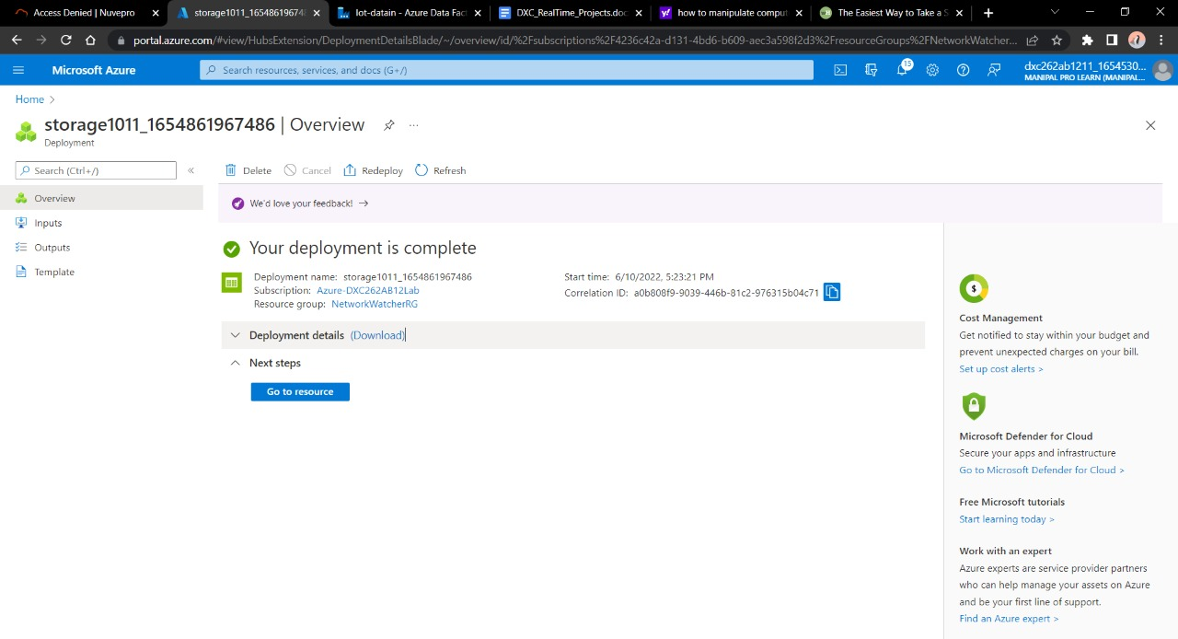
STEP 7:- Go to Azure , search for storage. Click on Storage Account. Click on + Create.
Fill up all the details and click on Review+Create. Deploy it :
Once deployment is done click on Resource Group.

Slide 9
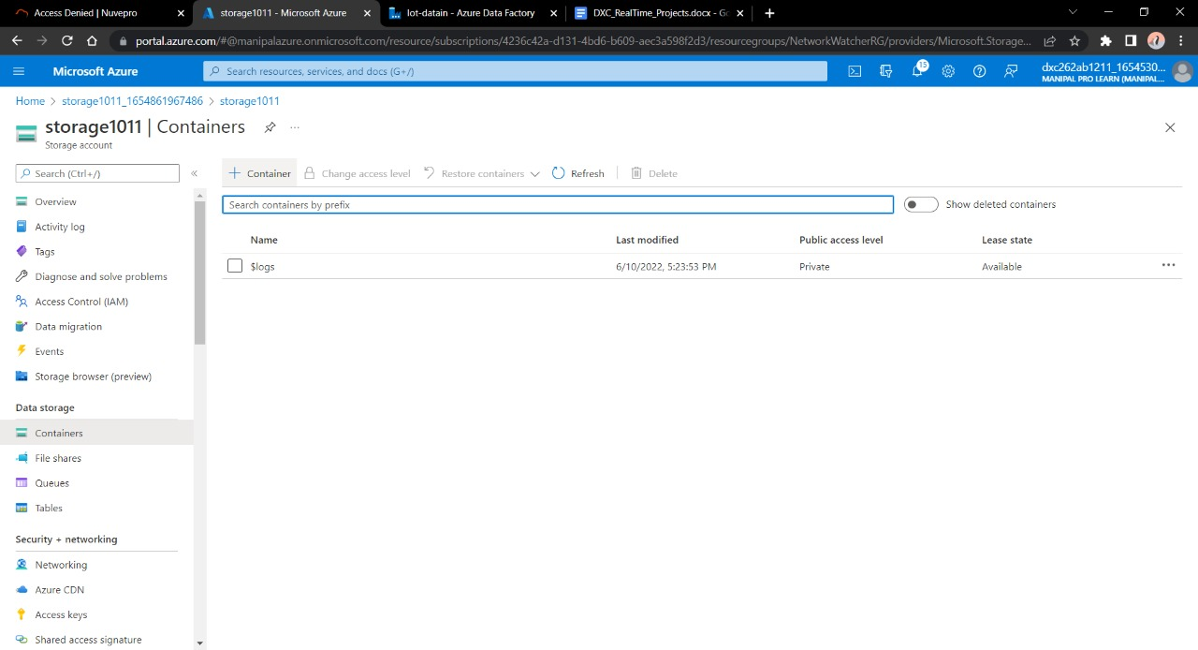
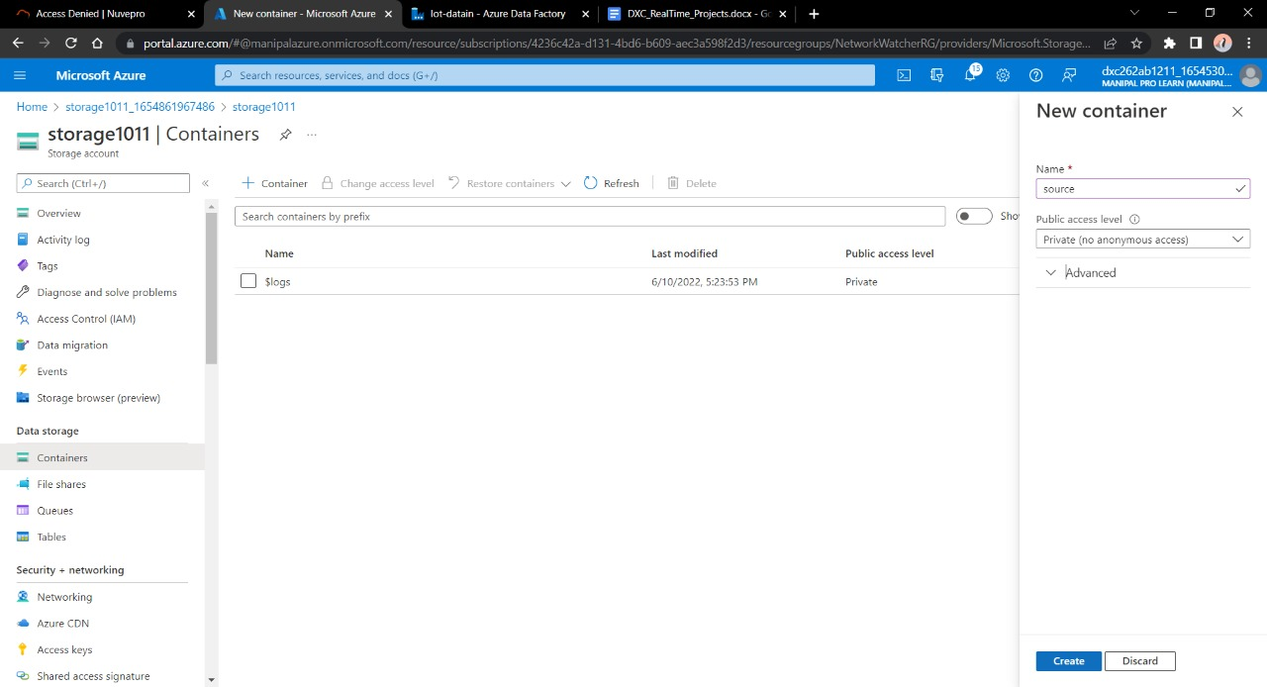
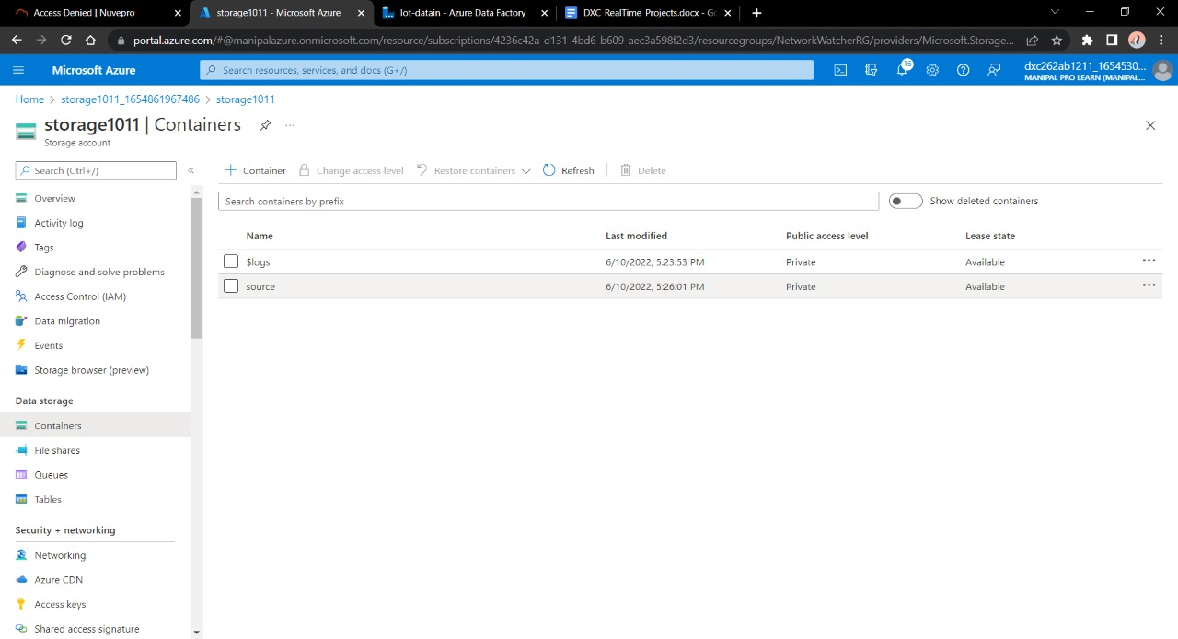
Navigate towards containers. Click on + Container.
Container is used in order to store the data. Click create.
Give a name to the container Click on upload.

Slide 10
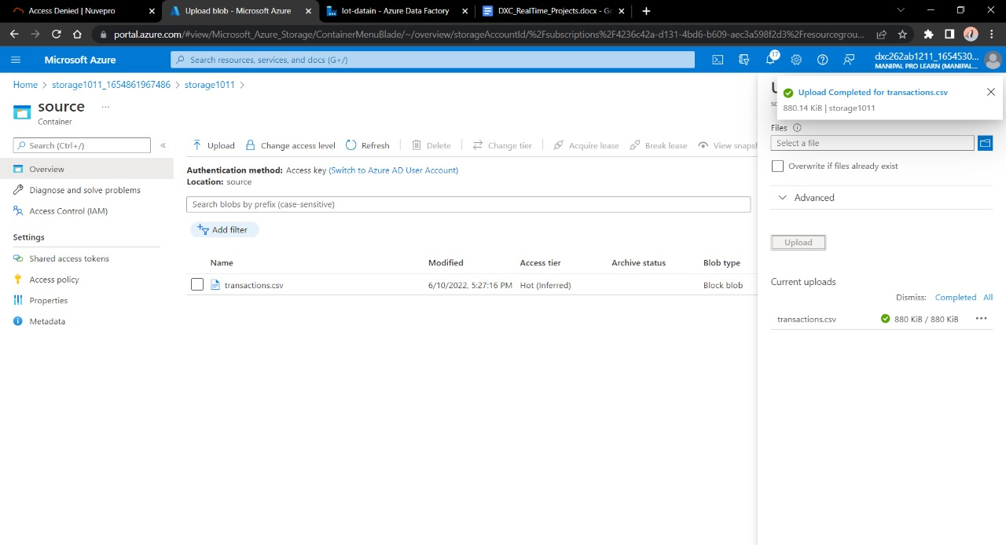
Considering we don’t have the source of the data we will make this container as the source of our blob data and will fill in a sample file to paste into the sql database .

Slide 11
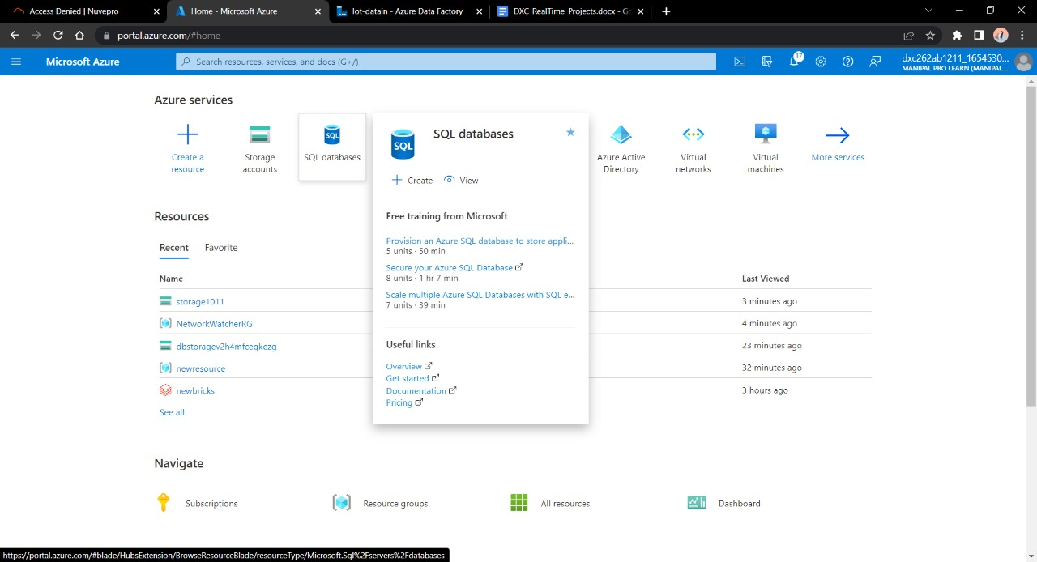
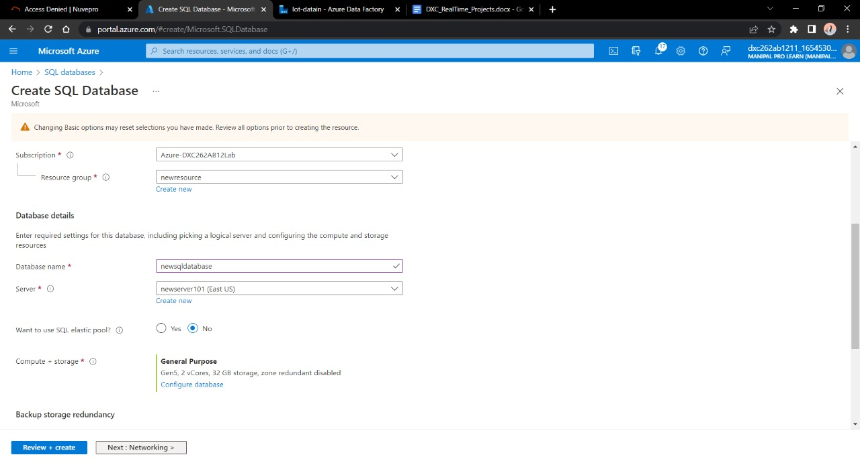
Now we need a SQL database to send the data to . Go to SQL DATABASES.
Open it. Fill the necessary details and deploy it.

Slide 12
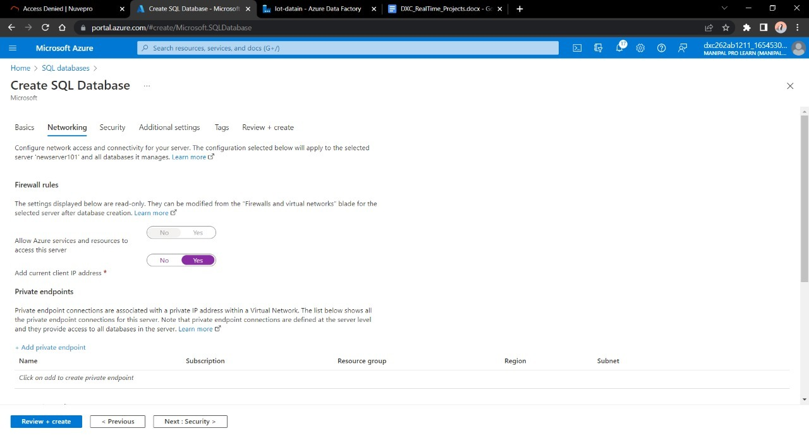
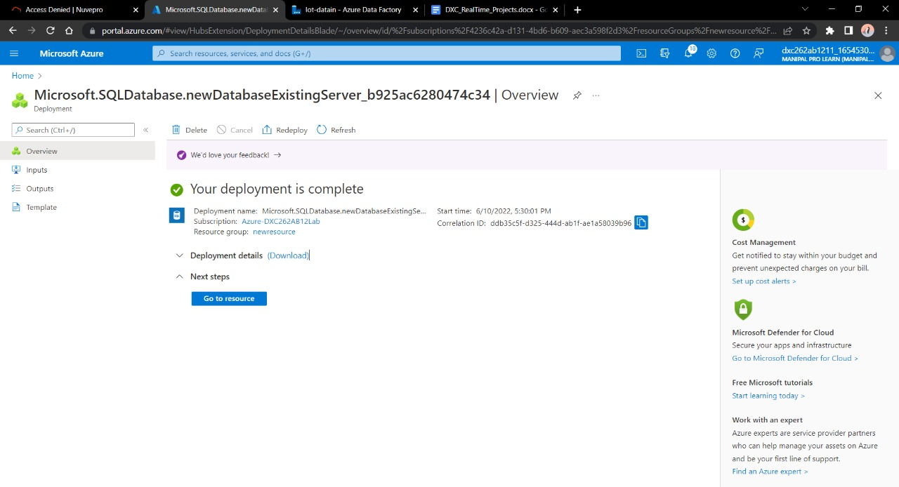
Make sure to enable the firewall for the current IP and for the same azure cloud otherwise connecting SQL database through Data Factory is not possible.
Go ahead to deploy the database

Slide 13
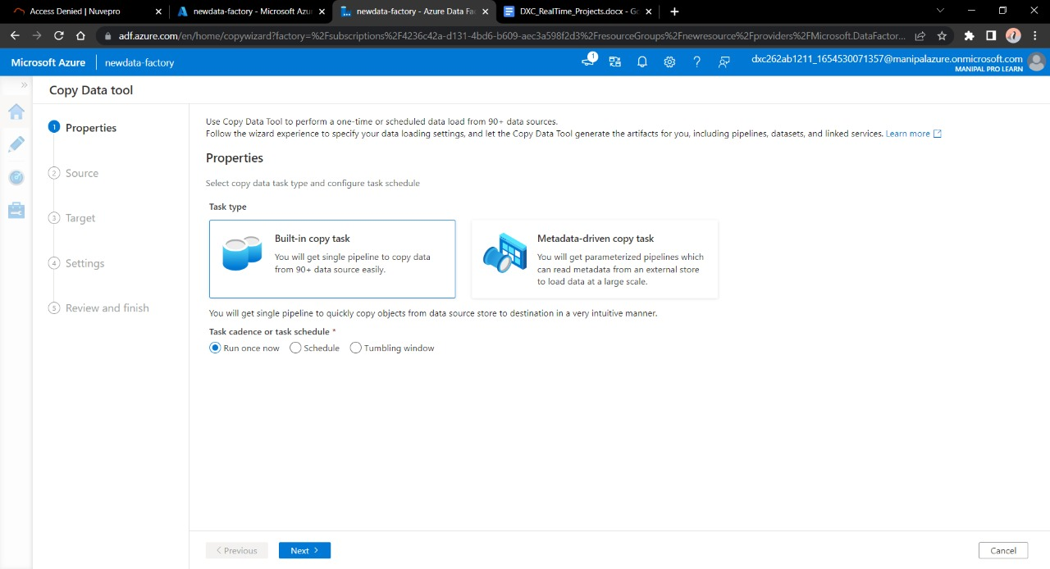
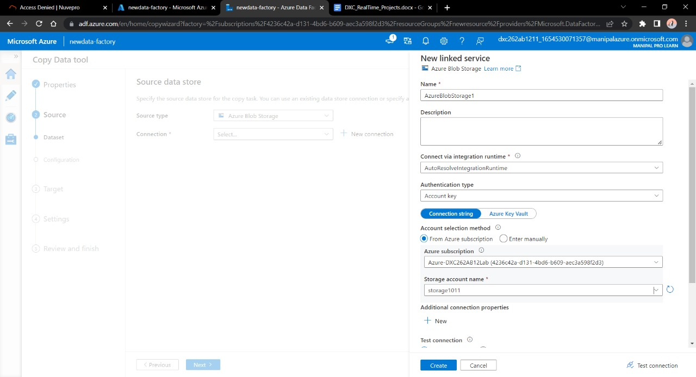
After these steps come back to Azure Data Factory Lab . Here we need to create a pipeline that will take data from blob storage and feed into the SQL database.
Click on ingest
Enter the name of Azure blob storage linked file. Select the name of storage account name we created in this and click on Create.

Slide 14
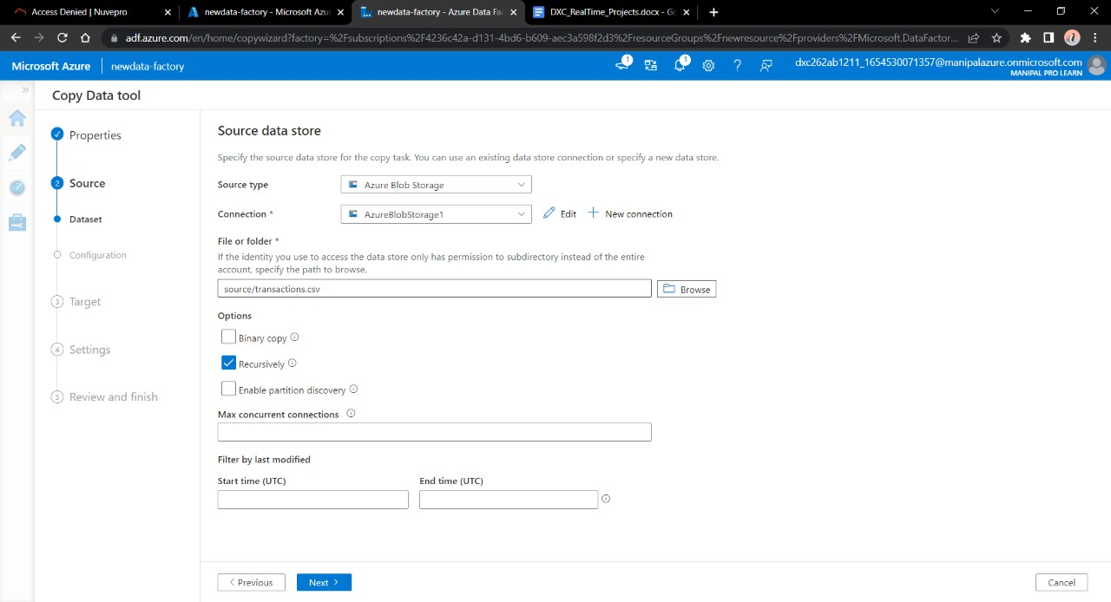
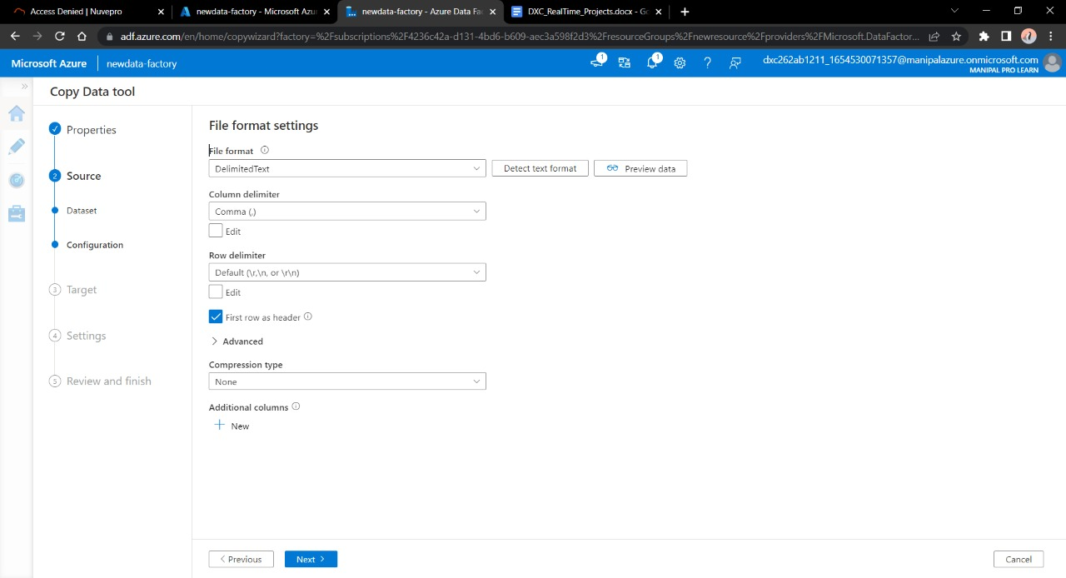
Select the source type as blob storage and connection name that we created in previous step. Click Recursively from Options. Click Next.
Choose the output format of the data

Slide 15
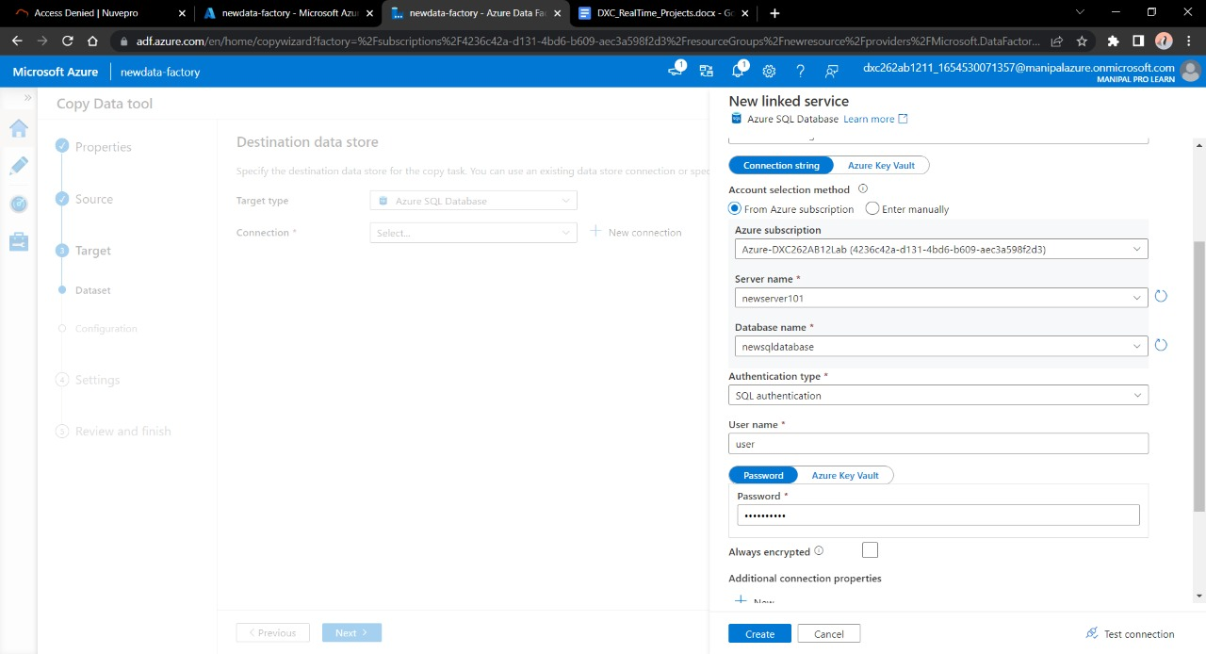
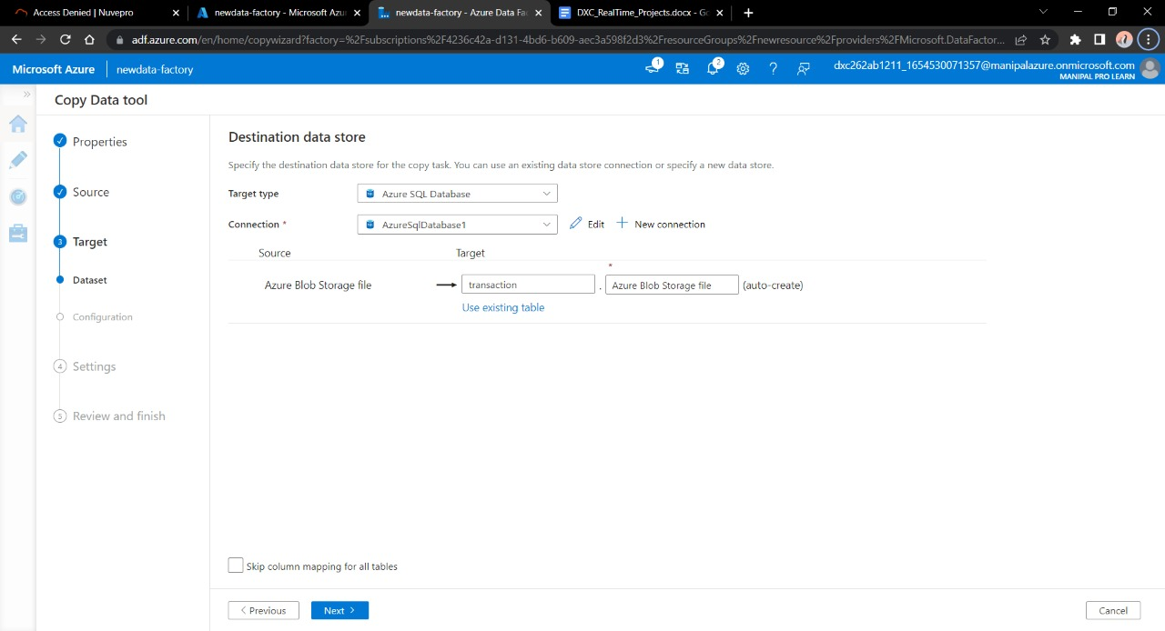
Now , in the next step we will link the Data Factory with SQL database .Connect the database with new connection.
Choose the file name you want to see in the SQL database. Click Next.

Slide 16
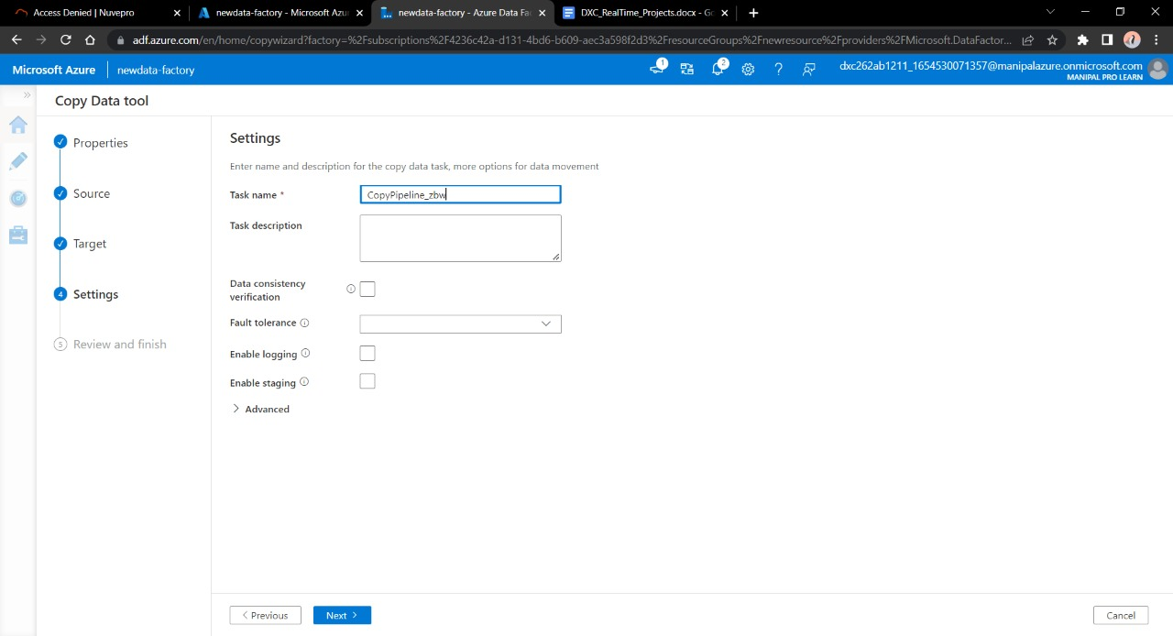
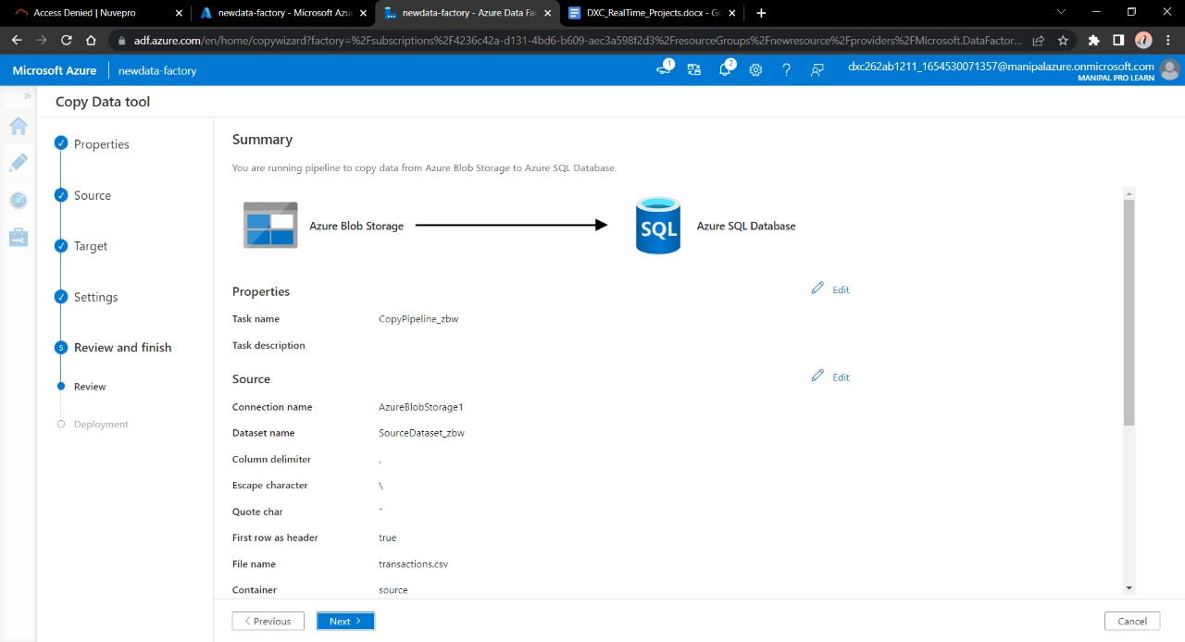
Now we are the end stage of creating pipeline, click next.
Validate the data , connection , details and move forwards with Next

Slide 17
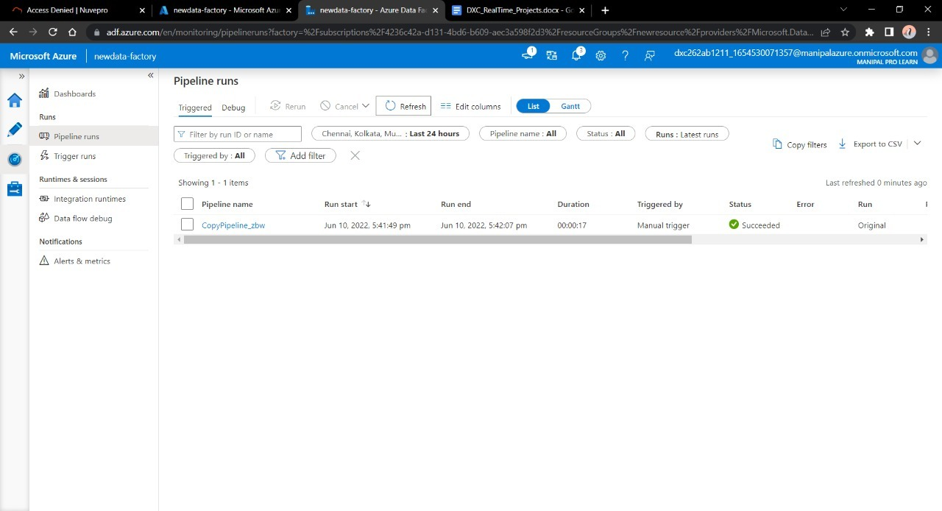
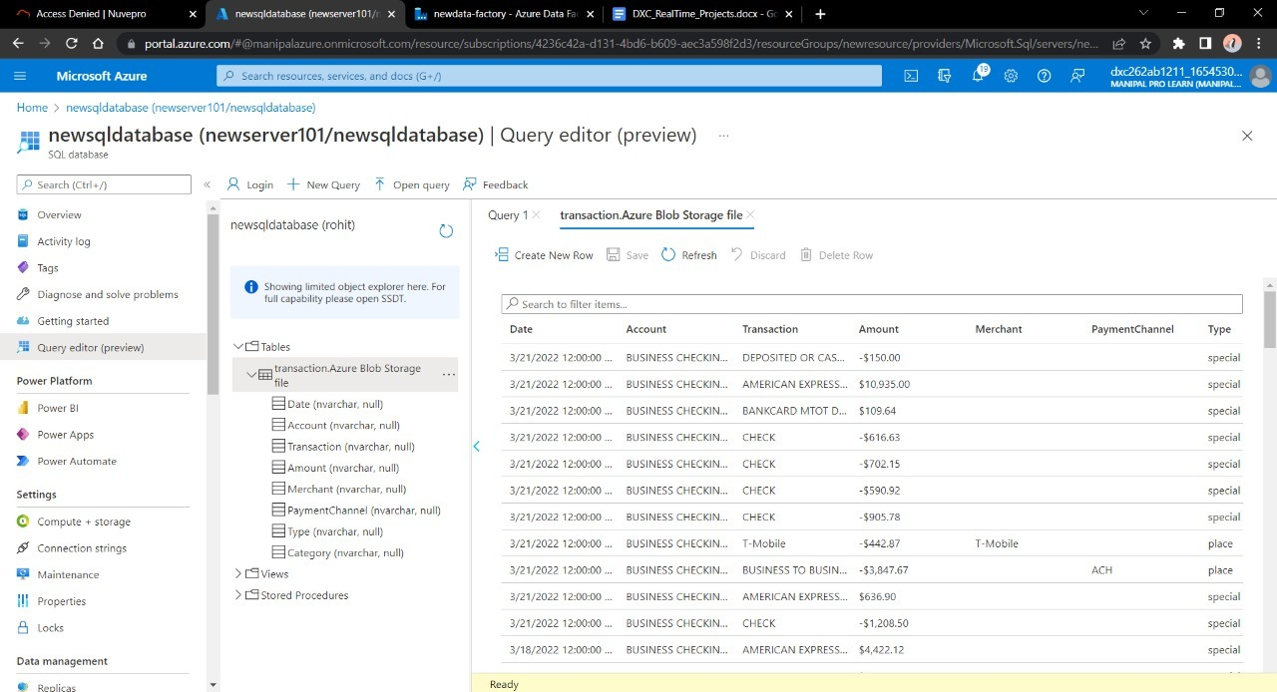
Trigger the pipeline manually and navigate towards monitor , Here we can see our pipeline has successfully ran once.
Navigate towards SQL database in order to check the data.

Slide 18
Result: In this project we were successful in creating a pipeline that will validate and copy the blob data into the SQL database using Azure Data Factory
Conclusion: The Blob data is being successfully validated and stored into SQL database.

Slide 19
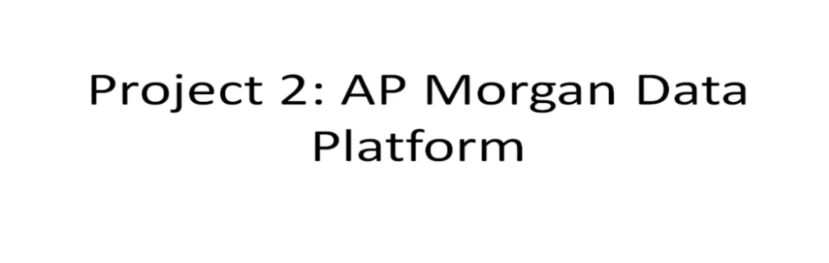

Slide 20
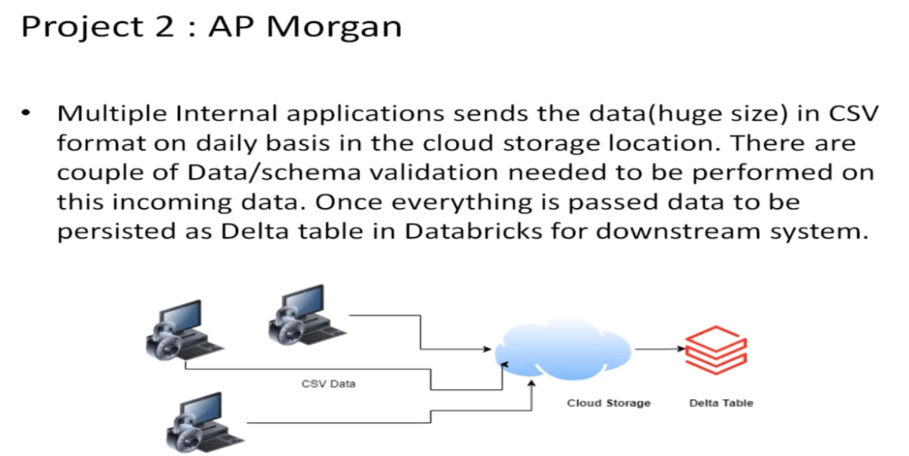

Slide 21
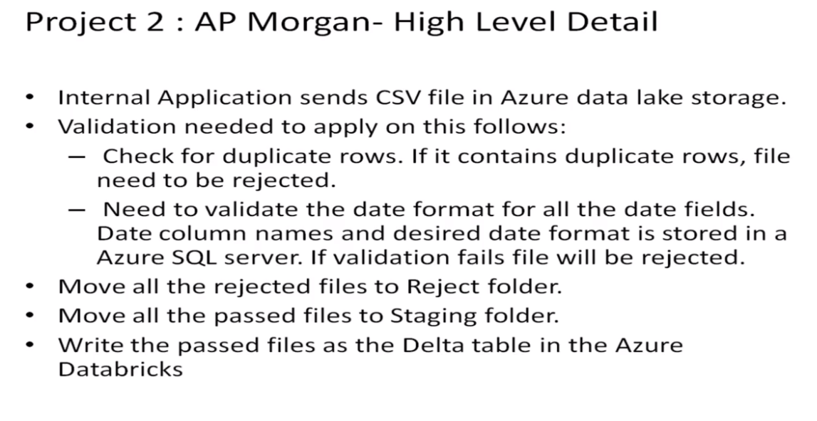
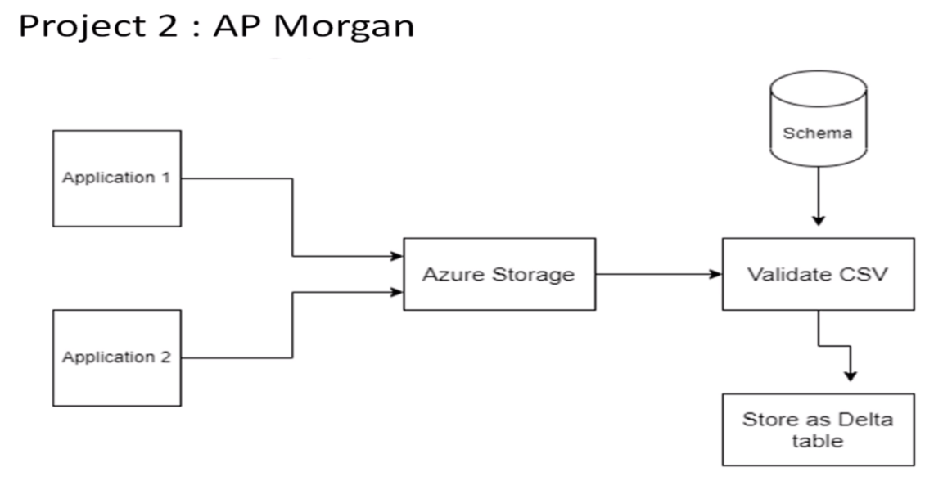

Slide 22
Practical Lab: Create a Databricks
Practical Lab: Create Cluster in Azure Databricks
Practical Lab: Add notebook in Databricks and Implement the Business Logic
Practical Lab: Azure Data Factory For AP Morgan
Practical Lab: Create Azure Databricks Linked Service in ADF

Slide 23
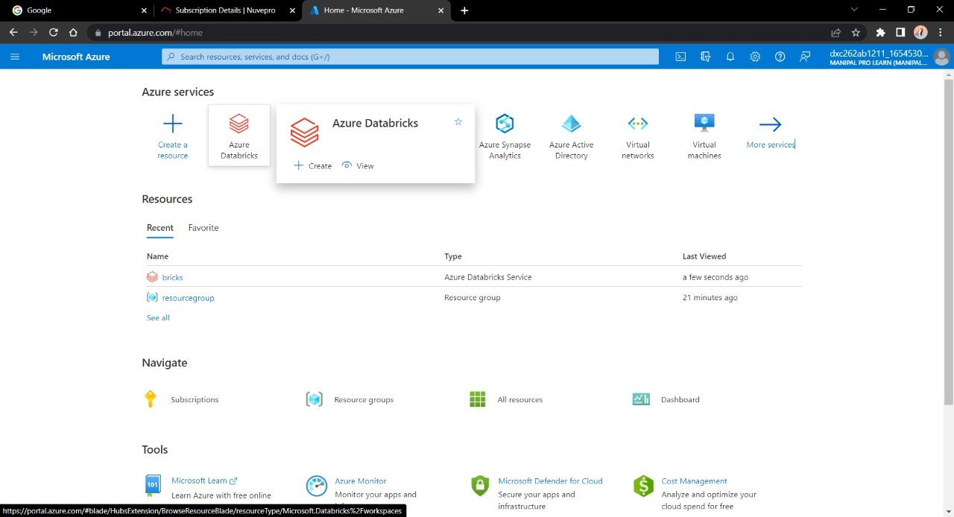
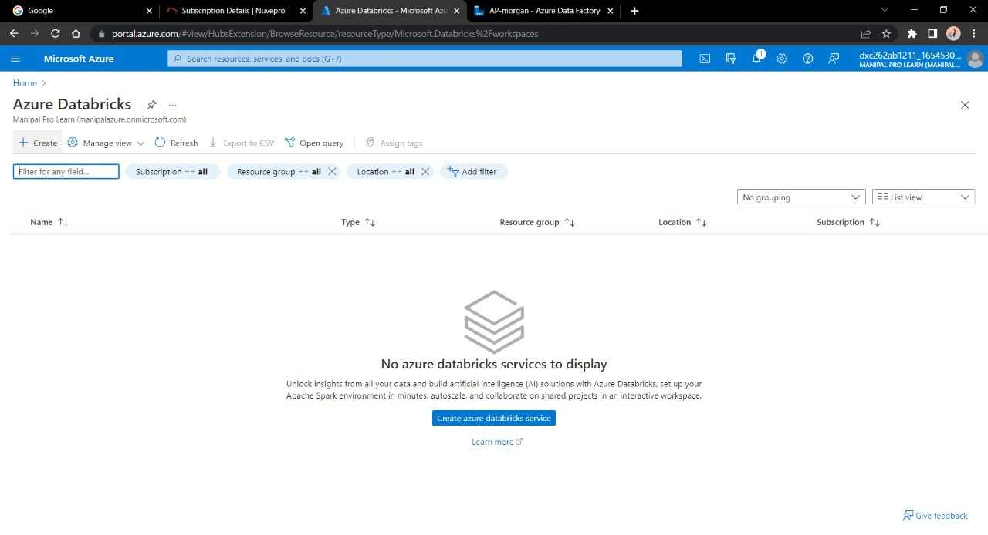
FOLLOW THE STEPS TO ACCOMPLISH THE TASKS:
Open Microsoft azure and create account for Data Factory and Azure Data Bricks
Search and open Azure Data Bricks
Now create a new account into the Data Bricks

Slide 24
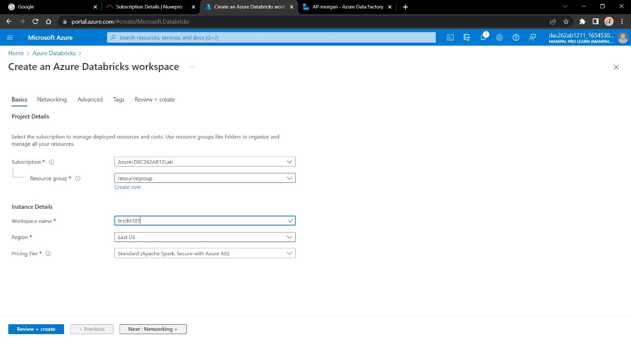
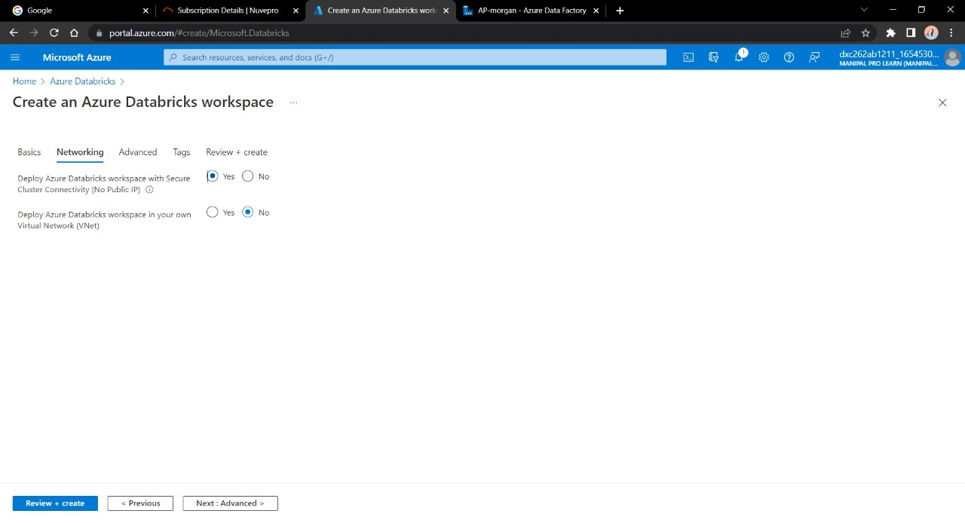
Enter the details regarding the account
Make sure to give permission for Cluster connectivity

Slide 25
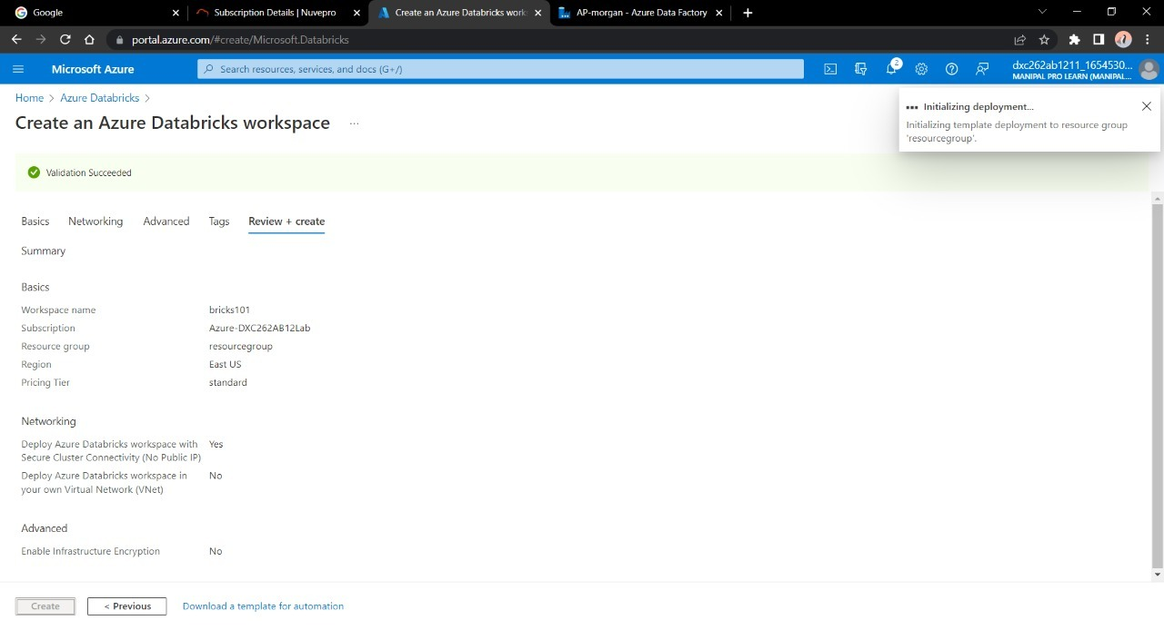
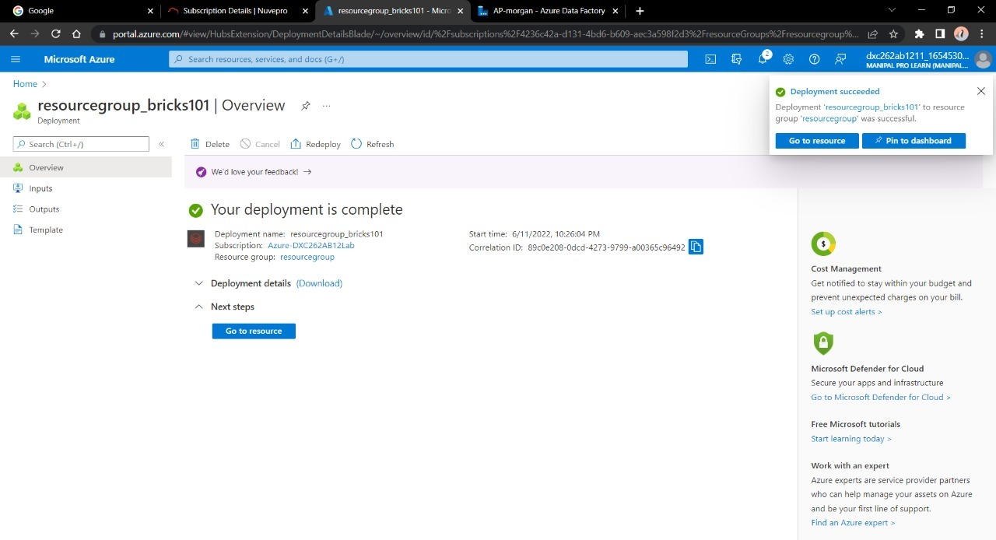
Validate and create a DataBricks account
After the deployment is done Navigate towards “Go to Resource”

Slide 26
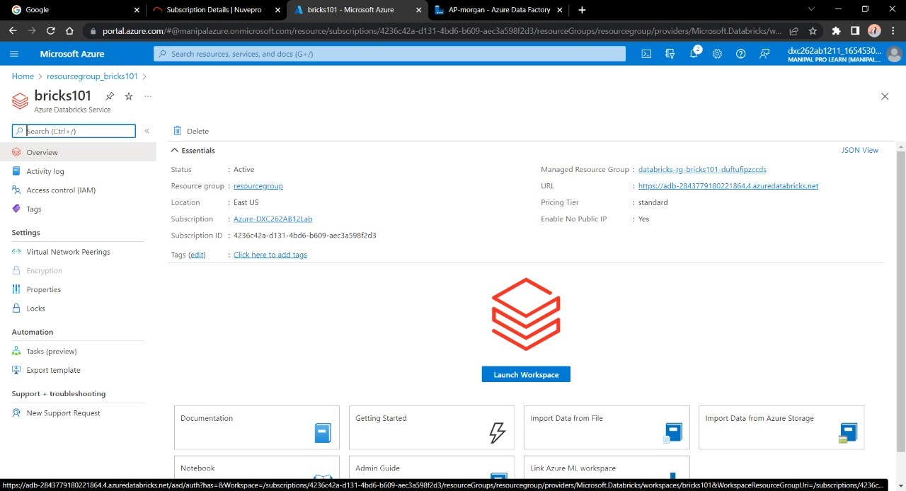
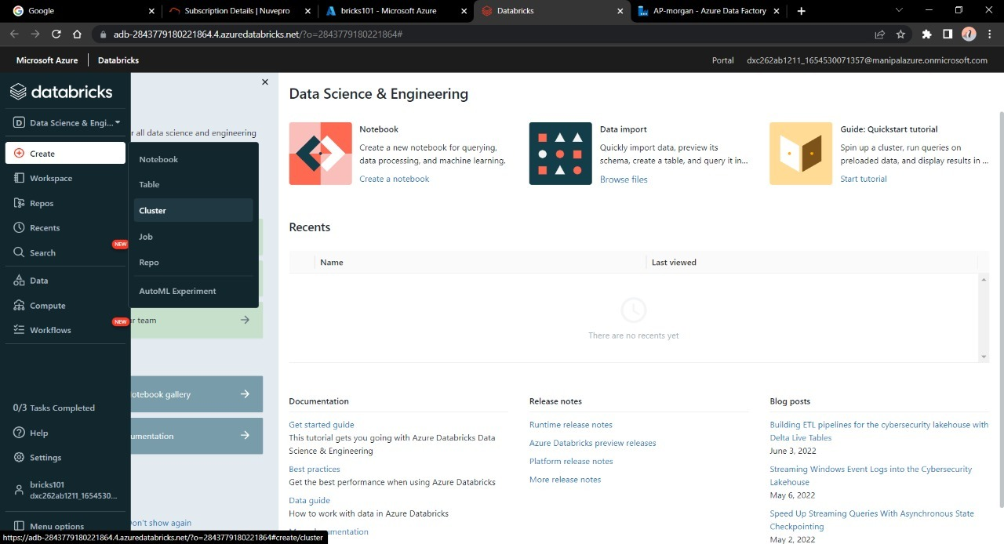
Launch the Workspace

Slide 27
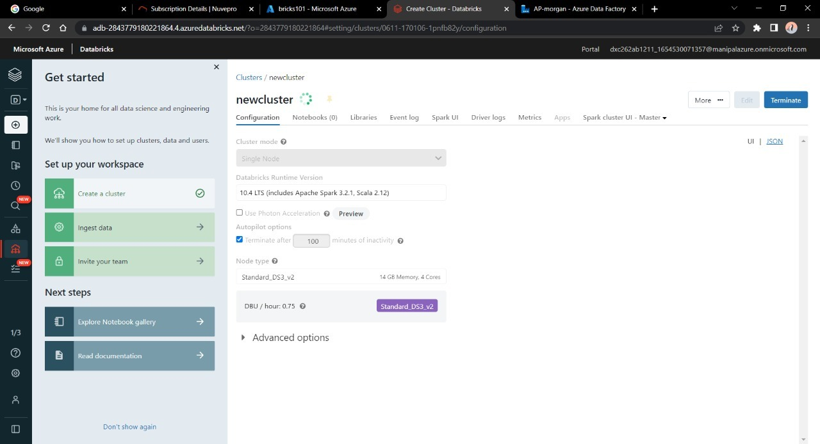
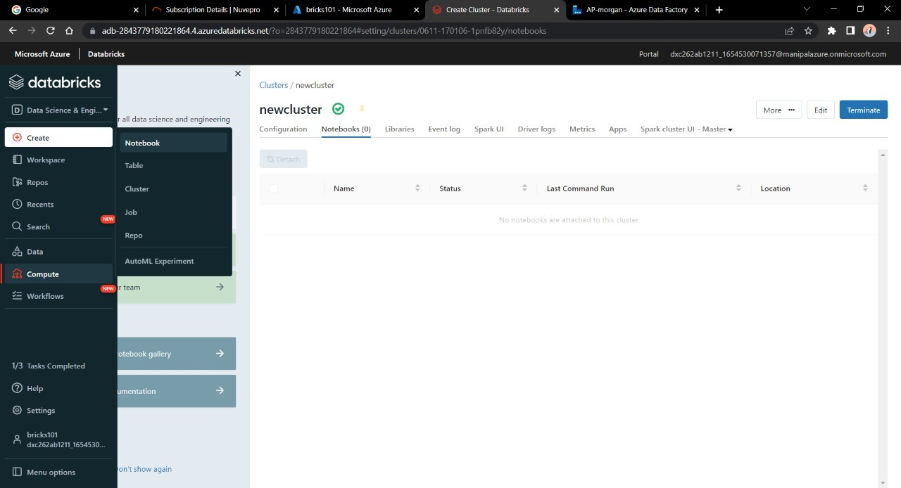
Create a new cluster to work upon
Give the necessary credentials for the cluster and click on create

Slide 28
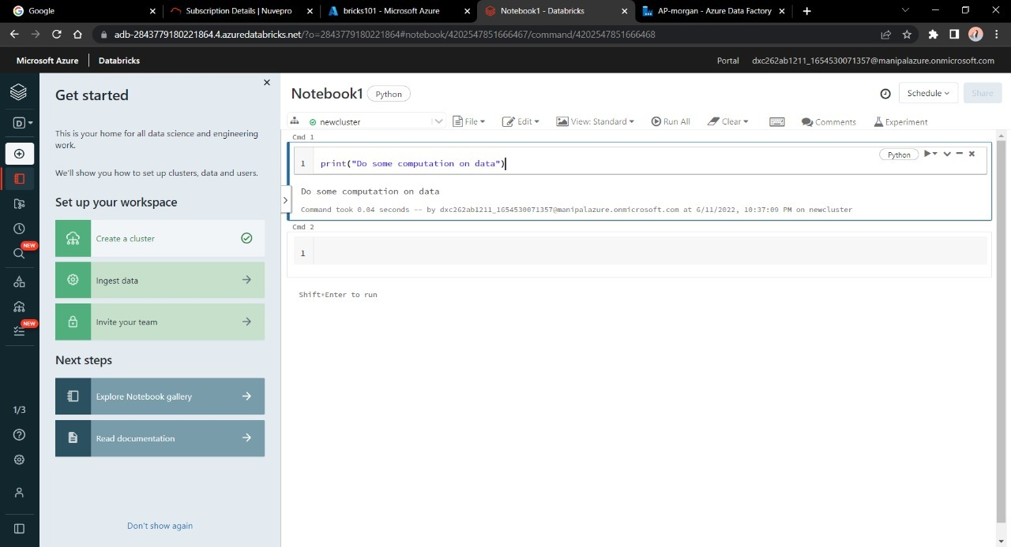
After creating a new cluster we need a notebook that will do some computation with the data present or incoming in databricks
Give some operation or Do the logic building in the notebook

Slide 29
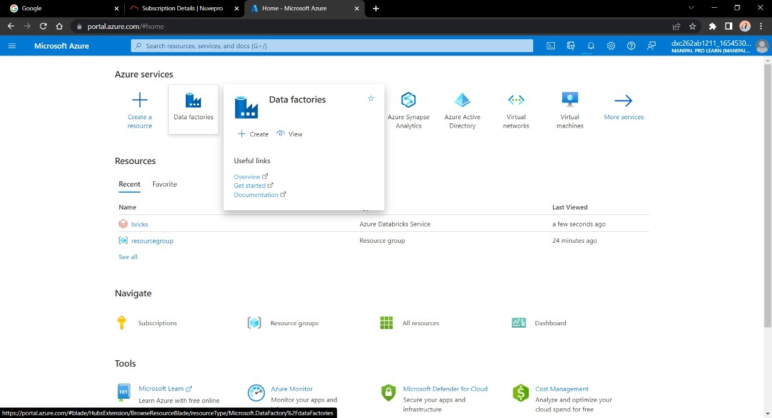
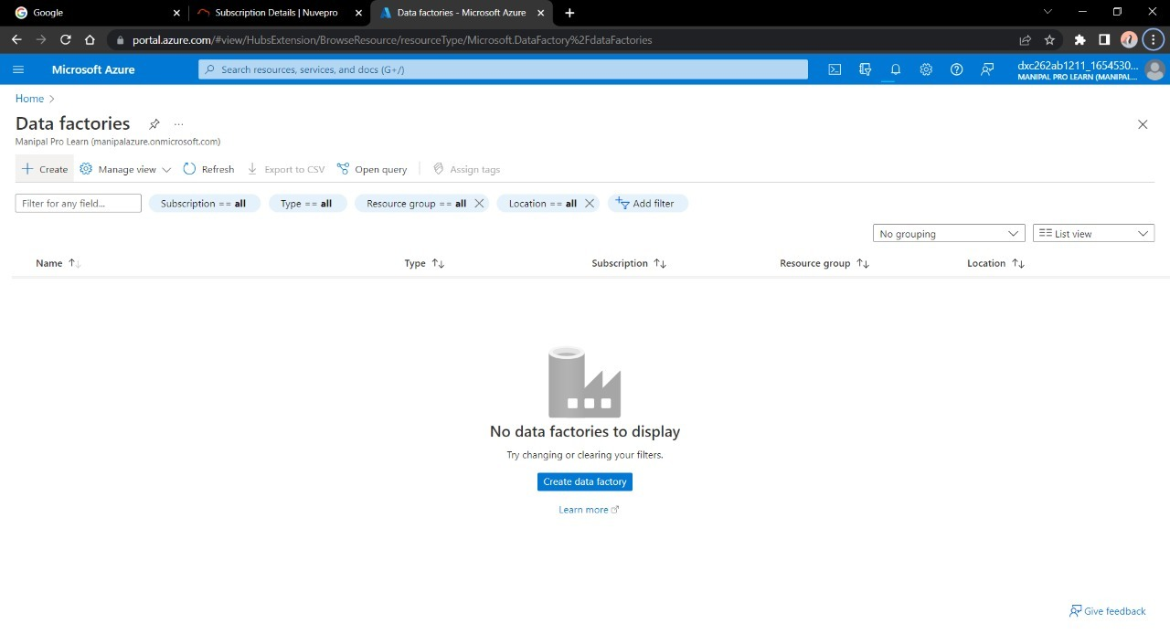
Now our notebook is ready to be linked and executed in Azure Data Factory
Go to azure home page and search for Data Factory
Create a new account on Azure Data Factory

Slide 30
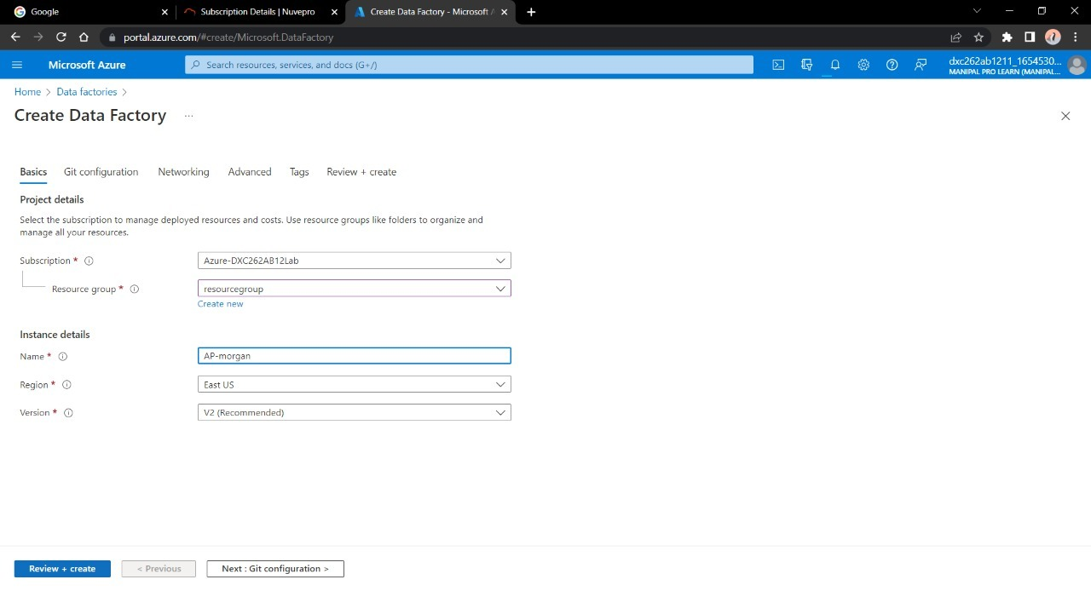
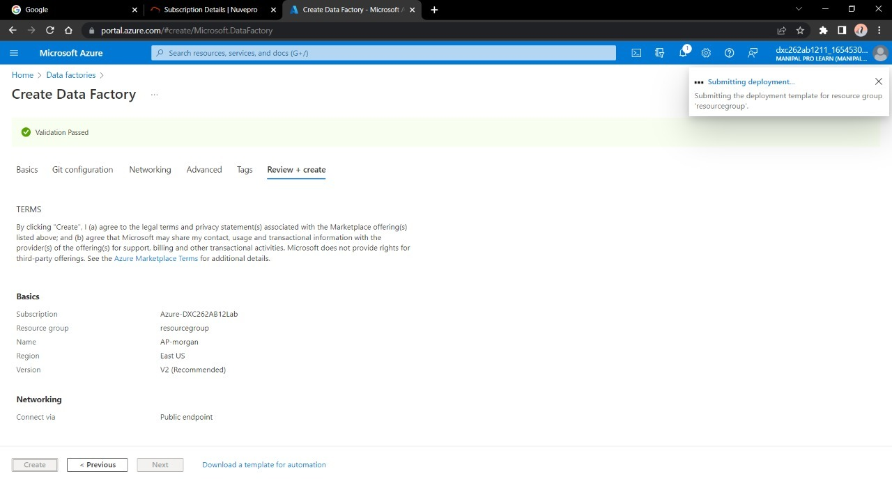
Enter the details for the factory account
Validate and deploy the Data Factory

Slide 31


After the deployment is done , Navigate to “Go to resource”
Now open the Data Factory studio

Slide 32


We need to create a pipeline that will connect Data Bricks notebook with Data Factory.
Create a new Pipeline and drag&drop the notebook tab from Azure Databricks dropdown into the pipeline workspace.

Slide 33


Create a new Linked service for databricks
We need the access token of Data bricks account in order to access it.
Navigate to Data bricks workspace and go to Users in settings

Slide 34


Click on “Generate token” and mention a small quick description name for the token
After that a tab will open containing your access token , copy it and paste it in the azure factory data connection form

Slide 35

Choose the right cluster and click on create

Slide 36

Now choose the notebook in the pipeline notebook tab setting in order to trigger it.
Publish the pipeline in order to trigger it , After publication is done click on “Trigger now”

Slide 37

Go to Monitor window in order to check it’s execution
Here we can see we have successfully triggered a linked notebook of Data bricks from Data Factory.

Slide 38
Result: Successfully able to link and trigger azure DataBricks notebook using Data Factory.
Conclusion: Azure Data Factory linked with Azure Data bricks
THNAK YOU

